Slide 1
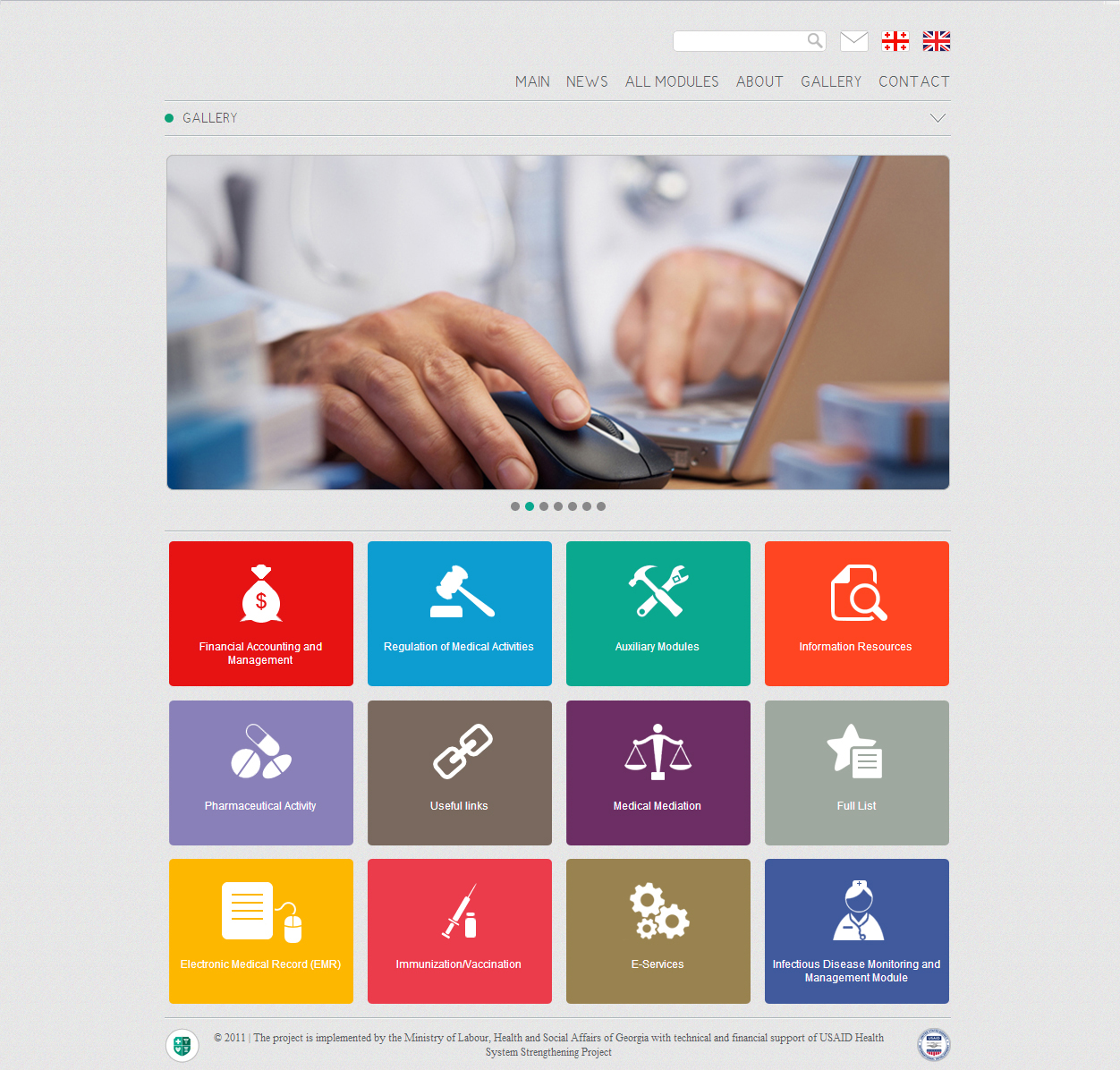


Health Management Information System (HMIS) Georgia
http://ehealth.moh.gov.ge/Hmis
USAID Health System Strengthening Project (HSSP)
October
2012

Slide 2
Health Management Information System - Mission
Health Management Information System – Main Characteristics
Information privacy and security
Common standard for data registration to ensure international comparability
Operational effectiveness and optimization of administration resources
Real-time monitoring of financial/healthcare data
Accurate statistics and analysis
Effective management of knowledge and experience; evidence–based clinical decision making
Policy and management decision making based on accurate data
Improved standardization and transparency of processes
Improved efficiency and control of healthcare programs

Slide 3

Main Components of Health Management Information System
Regulation of Medical Activities
Pharmaceutical Activities
E-Services
Pharmacy and Healthcare Network Information Portal
Medical Mediation
Immunization/Vaccination
User Management Module
Financial Accounting and Management
Medical Classifications
Analytic Tools

Slide 4


Functional Architecture of Health Management Information System
Access to information and services
Administration/management tools
Basic registers

Slide 5
Health Management Information System Stakeholders
Minister of Labor, Health and Social Affairs of Georgia (MoLSA)
Social Service Agency (SSA)
National Center for Disease Control and Public Health
State Regulation Agency for Medical Activities
Medical Mediation Service
Revenue Service
State Treasury - Ministry of Finance of Georgia
Not only healthcare providers involved in the government-funded program; all healthcare providers will be involved in the HMIS in the future
Rural Doctors
Insurance Companies
General Population

Slide 6

Regulation of Medical Activities Component
Benefits of Modules
Licensing and Permitting Module for Healthcare Facilities and Certification/Accreditation Module for Medical Staff
Accreditation
Certification
Regulation
of Medical
Activities
Reports
Keep electronic registers and enhance public information
Complete histories of healthcare facilities taking into account legal succession (related to licenses, permits, accreditation)
Information on medical staff training, their certificates and experience
Transparent information on suspension/revocation of the right to medical activity
In the future, information on distribution of medical staff by healthcare facility and geographic location
Licensing
Permits

Slide 7
Pharmaceutical Activity Component
Component Modules
Benefits of Pharmacy Module
Pharmacy Module
Registration of all functioning pharmacies and their identification according to type of activity
Registration of pharmacy and pharmaceuticals inspection results
Data standardization and prevention of duplicate entries
Pharmaceutical Products Module
Electronic Drug Registration in eCTD (Common Technical Document) Format
E-prescribing Module

Slide 8
Pharmaceutical Activity Component-II
Benefits of Pharmaceutical Products Module
Benefits of Electronic Drug Registration in eCTD (Common Technical Document) Format
A complete list of pharmaceuticals permitted in Georgia
Opportunity for real-time exchange of information on import/export of drugs with the Revenue Service
Capability to ensure citizens’ safety, by proper drug surveillance mechanism using the unique drug code
Data standardization and prevention of duplicate entries
Ability of medical staff to make informed decisions based on drug annotations and different medical/scientific information
Standardization of normative and technical dossier along with expertise processes
Compliance of the registration process with international standards and technical possibility to connect reliable regulators to analogous registration interface
Registration of high-quality drugs
Timely optimization of financial and technical resources
Data systematization and simplified data search

Slide 9
Pharmaceutical Activity Component- III
E-Prescribing Module
Benefits of the Module
Centrally mobilized data; opportunity to gather reliable statistics and make an analysis
Ensure cost-effective care, making informed and evidence-based decisions
Control of the limit for drugs covered under government-funded and private health insurance plans
Eradication of fraud and duplication of care
Renewal of prescription for patients with chronic diseases without visiting doctors
Timely optimization of financial and technical resources based on electronic reporting
In the future, software that will ensure access to medical/scientific resources while rendering medical services

Slide 10
E-Services Component
Benefits of the Component
Simplifying information exchange between the Ministry of Labour, Health and Social Affairs (MoLHSA ) and other stakeholders
Getting electronic permits and documents
Reducing the costs related to paper documents
Receiving/exchanging fast and reliable data online

Slide 11
Pharmacy and Healthcare Facility Information Portal
Benefits of the Portal
Access to geographic, offered services and price-based information on medical services
Access to geographic and cost-based information on pharmaceuticals
Ability to exercise choice over selected clinics and pharmacies
Price transparency
Saved administrative resources

Slide 12
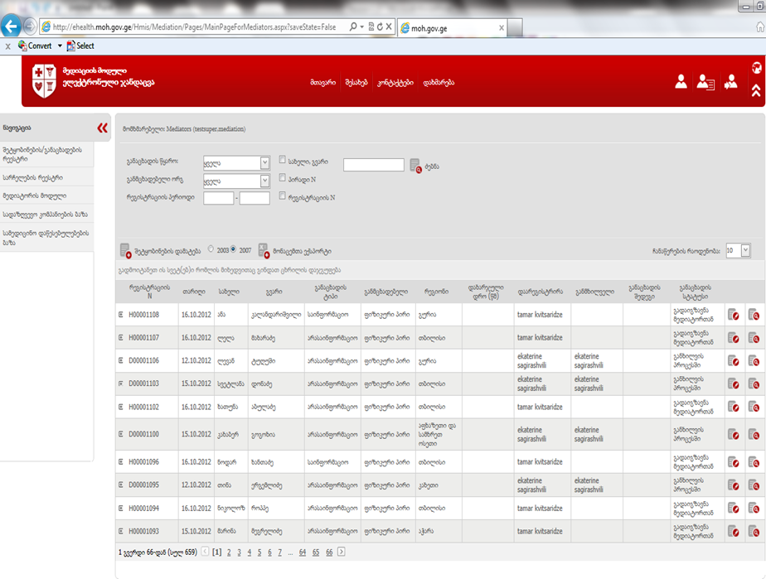
Medical Mediation
Benefits of the Component
Real-time registration of applications using common standards
Electronic administration and management of applications/cases
Simple, timely and flexible system
Statistical observation and analysis
Flexible mechanisms for application revision
Simple inter-party feedback system

Slide 13
Immunization/Vaccination
Ministry of Labor, Health and Social Affairs of Georgia
Level 4
District PHC Centers
Level 2
Pediatricians/
internists
Level 1
Family doctors
Level 1
Rural doctors
Level 1
Immunization specialists
Level 1
Out-patient facilities, polyclinics, healthcare centers
Level 1
Regional Centers of National Center for Disease Control and Public Health
Level 3
National Center for Disease Control and Public Health
Level 4
Needs Related to Immunization
Process management and monitoring – registration and control of the immunized population
Reporting - centralized reporting on coverage of the population and other types of information flows
Stock management –information on utilization, stock in hand, requirements, losses, etc.
Analysis – statistical and epidemiological analysis

Slide 14

Immunization/Vaccination Weaknesses Revealed by Situational Analysis
Problems related to data collection, standardization, monitoring and analysis
Huge unorganized and non-standardized paper-based archive
Lack of centralized database and essential electronic services
Lack of complete immunization histories of some beneficiaries
Limited statistical research opportunities
Delayed exchange of information between parties

Slide 15
Immunization/Vaccination Goal of Module
Real-time monitoring of preventive vaccines and vaccination process
Technical support for entering complete and accurate data
Automation of necessary reporting requirements and reports themselves
Real-time beneficiary migration monitoring
Notification and information system for providers and population
Real-time data generation in relation to the covered population and the individuals eligible for immunization
Reduced inventory, labor and administrative costs
Maintaining statistics based on highly reliable data
Determination of vaccine and associated medical supply needs

Slide 16
Immunization/Vaccination
Benefits of the Component
Complete registration and monitoring of the target population
Centralized data and simplified administration (based on reports submitted in hard copies)
Monitoring of vaccine spending
Opportunity to make reliable statistical and epidemiological analysis

Slide 17
User Management Module
Benefits of the Module
 | Ministry of Labour, Health and Social Affairs | Insurance Company | Provider
Tool to manage users and their access levels | ☑
A complete list of users for all information modules | ☑ | ☑ | ☑
Mandatory single authorization (single sign -on) to access modules | ☑ | ☑ | ☑
Opportunity to manage users and access levels for appropriate facilities independently | ☑ | ☑ | ☑
Possibility of integration of external information systems with the user and access level management module | ☑ | ☑ | ☑

Slide 18
Financial Accounting and Management Component
Financial Management of Healthcare Programs Module
Case Registration Module
Beneficiary Registration Module
- General Out-patient Care
- Rural Doctors
- Dialysis
- Psychiatric Care
- Antenatal Care
E-Reporting Module for Insurance Companies
E-Reporting Module for Healthcare Facilities

Slide 19
Financial Management of Healthcare Programs Module
Benefits of the Module
Electronic registration and management of contracts, including their terms and conditions, concluded with healthcare facilities under government-funded healthcare programs
Controlling and analysis of estimations submitted by healthcare facilities under government-funded healthcare programs
Automatic procedures for payment made to healthcare facilities under government-funded healthcare programs
Real-time data exchange with the State Treasury
Complete analysis of financial resource flow within government-funded healthcare programs
Flexible tool for management of budget units, financial limits and relevant changes

Slide 20
Case Registration Module
Benefits of the Module
Real-time case registration using common standards
Automatically entered/ synchronized personal data and insurance status of the patient (migration of data from the National Association of Public Registry database)
Providing parties involved in medical cases with timely electronic information
Automatic identification of healthcare facilities and medical personnel
Prevention of simultaneous registration of individuals in different healthcare facilities
Case inspection and analysis

Slide 21
Beneficiary Registration Module
Benefits of the Module
Provision of lists of beneficiaries to all healthcare facilities and rural doctors countrywide
Data registration using common standards; Medical record keeping (out-patient card)
Registration of one individual in only one healthcare facility that eradicates duplication
Identification of civil, insurance and other statuses of individuals in different registers
Financial transparency
Simplified administration and reduced costs; effective utilization and forecasting of government funds
Flexible mechanism of calculation of payment amount within the state out-patient program
Opportunity to analyze information from different angles

Slide 22
E-Reporting Module
E-Reporting Module for Insurance Companies and Healthcare Facilities
Benefits of the Module
Common standards for data registration and exchange (common registration forms and invoices)
Minimum probability of inaccurate data entered by users
Data identification and validation with databases of internal and external agencies
Effective utilization of budgetary resources; transparent funding and saving human and administrative resources
Opportunity for multi-level analysis of information

Slide 23
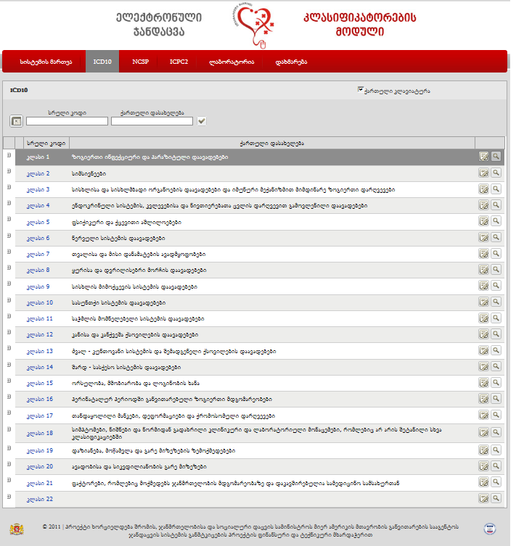
Medical Classifications
Benefits of the Component
Database of medical classifications approved in Georgia (ICD10, NCSP, ICPC2, laboratory classification)
Constantly updated information on classifications and their inter-relationship
Instrument for classification content management/improvement
Electronic portal and services to ensure communication with external systems

Slide 24
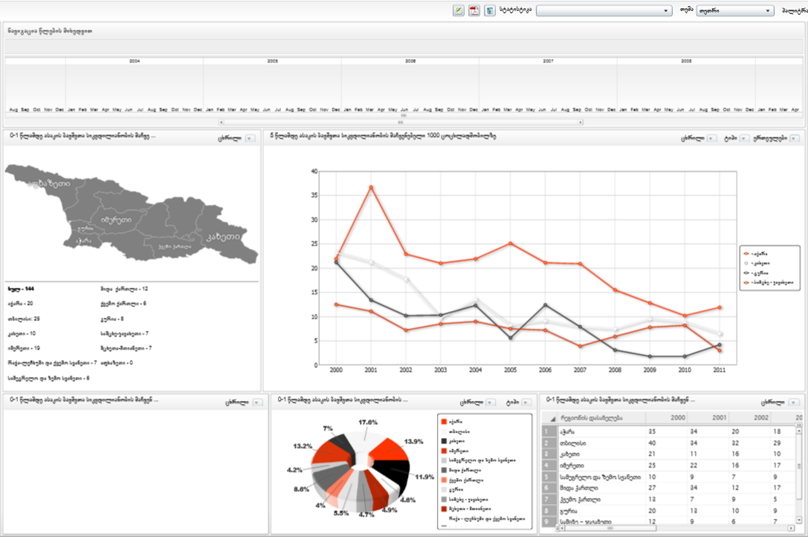
Analytic Tools
Benefits of the Component
Opportunity to generate analytical diagrams and graphics based on collected data
Comparison, monitoring and analysis of information flows according to different indicators
Dynamic graphics generated based on data received from various sources
Opportunity to analyze information from different angles (time interval, geographic distribution, etc.)

Slide 25
New Modules are coming with New Ideas…

Slide 26
Health Management Information System Website
http://ehealth.moh.gov.ge/Hmis/Portal/Default.aspx
User Manuals and Video Tutorials in English language can be found in Help menu of each module.
Thank you for attention!

